Slide 1
Microprocessor System Design IO Applications
Omid Fatemi
(omid@fatemi.net)

Slide 2

ADC and DAC Programming in AVR
The AVR microcontroller
and embedded
systems
using assembly and c

Slide 3
Topics

Slide 4
Outline
DAC (Digital to Analog Converter)
ADC (Analog to Digital Converter)
ADC major characteristics
ADC in AVR
AVR ADC Programming
ADCH and ADCL
ADMUX
ADCSRA
Signal conditioning and sensors
PWM (pulse width modulation) signals
DC motor control

Slide 5
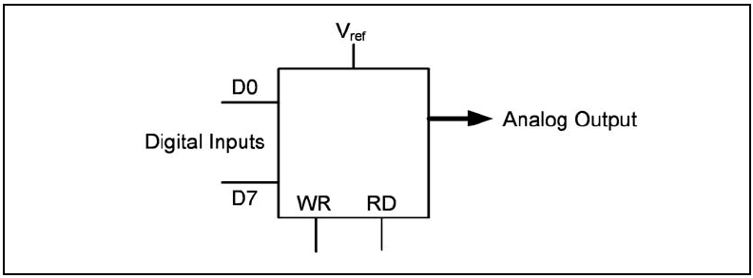

DAC
What is DAC ?
How to connect an DAC to micro?

Slide 6
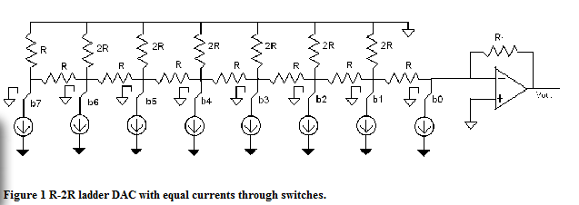
8-bit R-2R Ladder Digital To Analog Converter

Slide 7
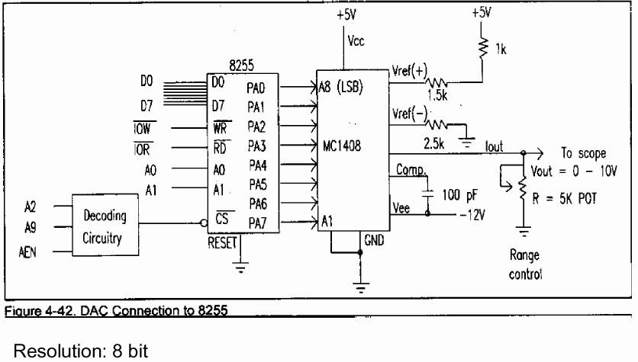
Digital to Analog Converter

Slide 8
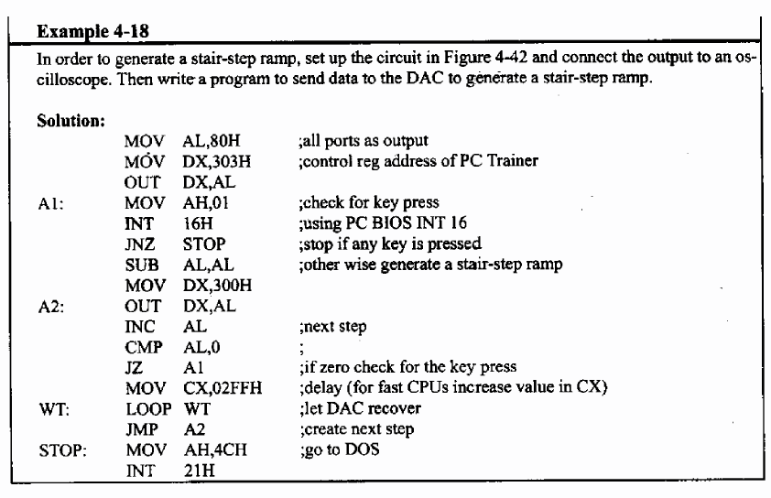
Example – Step Ramp

Slide 9
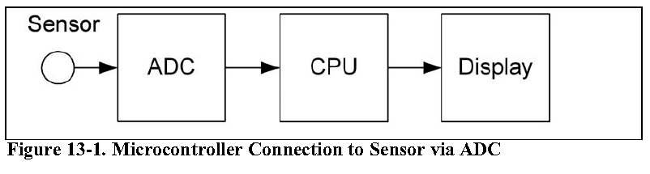
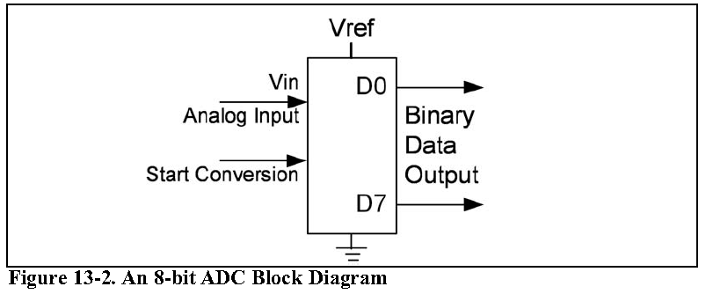
What is ADC? Do we need it?
Analogue vs. digital signal

Slide 10
ADC major characteristics
Conversion Time
Resolution
Vref
Parallel vs. serial
Input channels
Step Size

Slide 11
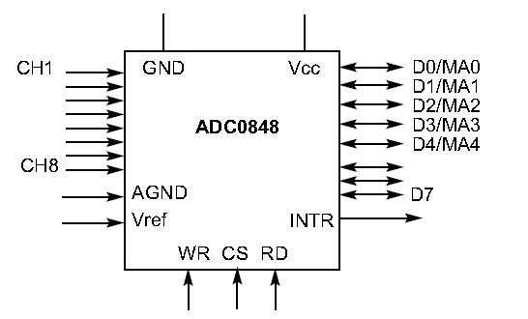
Some of ADC Signals
Dout = Vin / Step size
( in 8 bit ADC and Vref = 2.56 what is D out for 20mV input voltage?)
Start of Conversion
Channel Selector

Slide 12
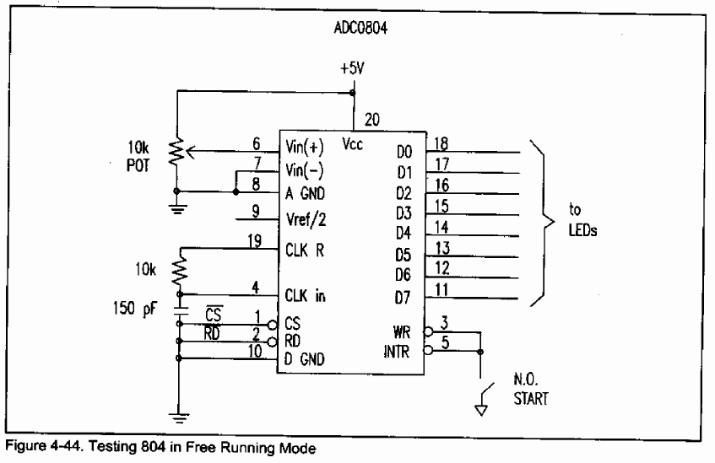
Analog to Digital
F = / (1.1 RC), 66 cycles
R = 10k, C= 150 pico, f =606khz , conversion 110 micro sec
Notes:
F = / (1.1 RC), 66 cycles
R = 10k, C= 150 pico, f =606khz , conversion 110 micro sec

Slide 13
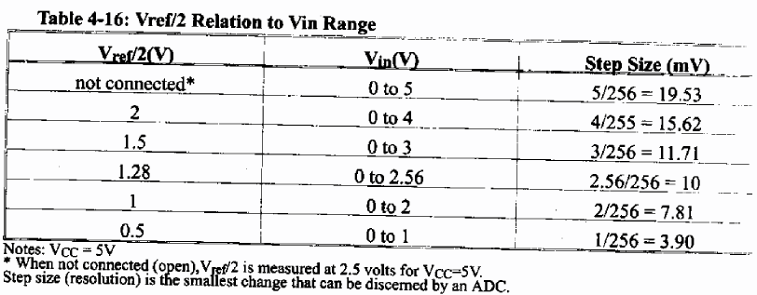
V_{in} Range

Slide 14
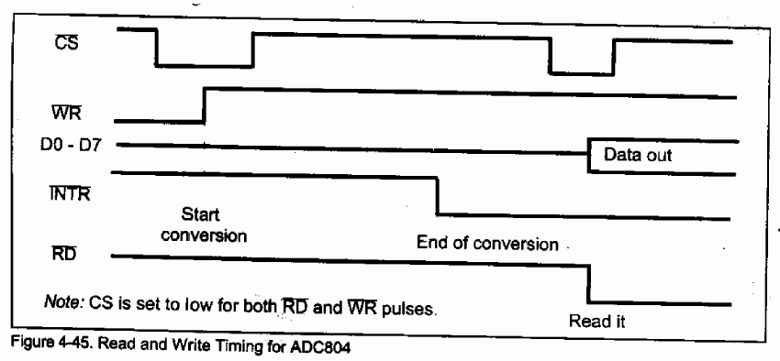
Timing
When intr is cleared?

Slide 15
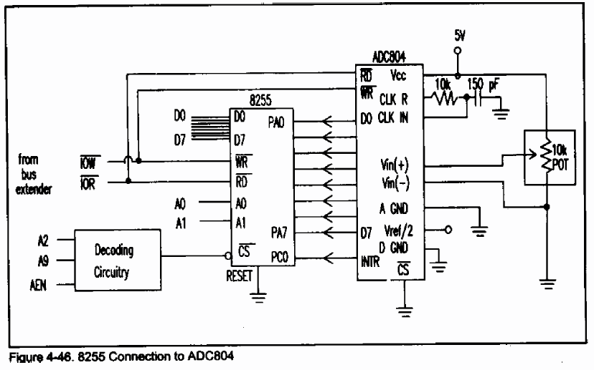
Interfacing ADC

Slide 16
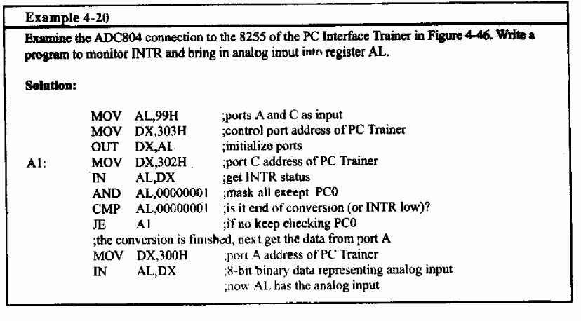
Example

Slide 17
ADC in AVR (Atmega 16/32)
10-bit Resolution
65 - 260 μs Conversion Time
Up to 15 kSPS at Maximum Resolution
8 analogue input channel
7 differential input channel
2 differential input channel with 10x or 200x gain
3 source of Vref
Internal 2.56V Vref generator
Free Running or Single Conversion Mode
Interrupt on ADC Conversion Complete
Notes:
• 0.5 LSB Integral Non-linearity
• ±2 LSB Absolute Accuracy
8 Multiplexed Single Ended Input Channels
• 7 Differential Input Channels
• 2 Differential Input Channels with Optional Gain of 10x and 200x(1)
• Optional Left adjustment for ADC Result Readout
• 0 - VCC ADC Input Voltage Range
• Selectable 2.56V ADC Reference Voltage
• ADC Start Conversion by Auto Triggering on Interrupt Sources

Slide 18
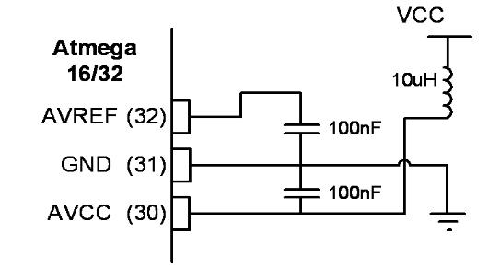
Hardware Consideration

Slide 19
ADCH and ADCL Data registers
ADCH:ADCL store the results of conversion.
The 10 bit result can be right or left justified:
ADLAR = 0
ADLAR =1

Slide 20
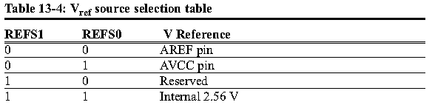
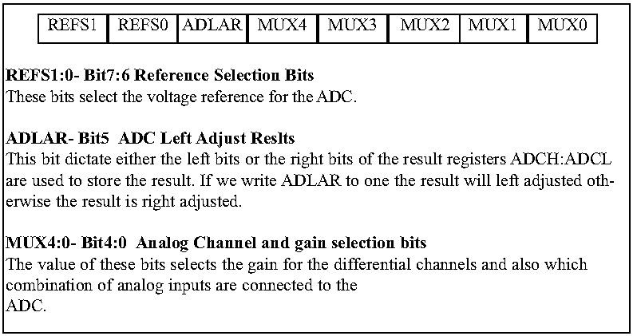
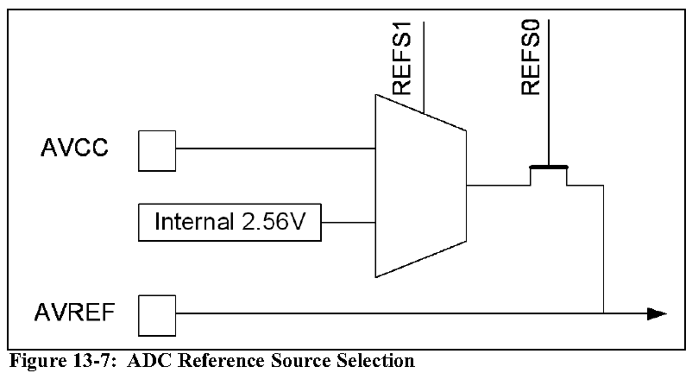
ADMUX

Slide 21
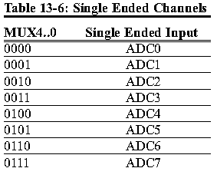
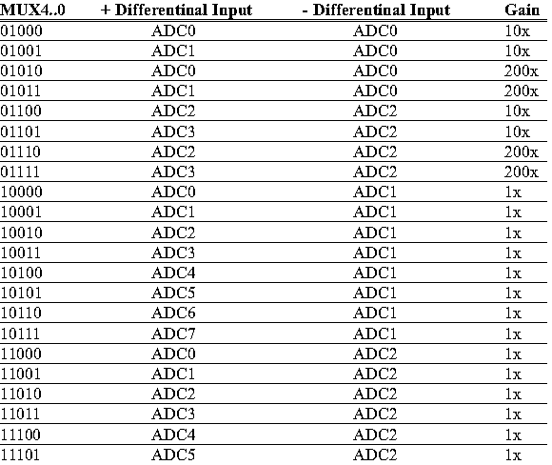
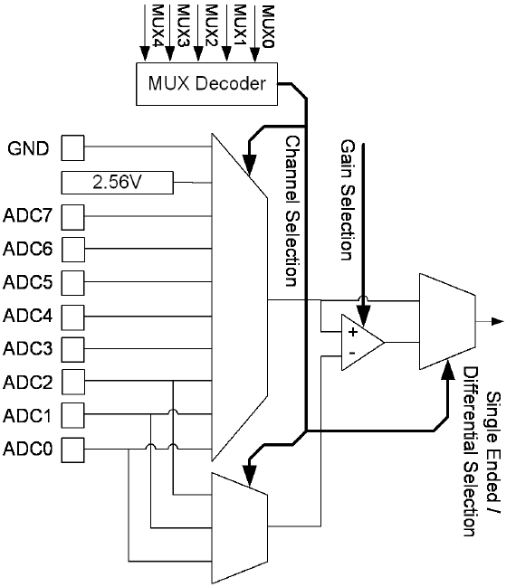
ADC input selection

Slide 22
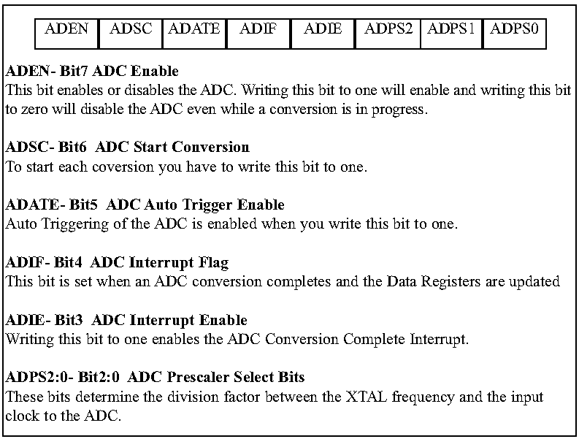
ADCSA

Slide 23
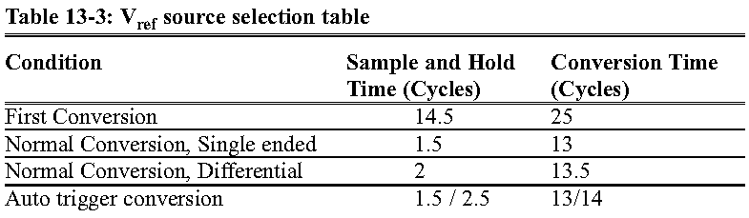
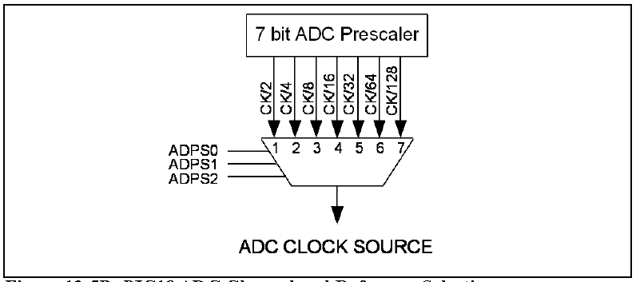
ADC Prescaler
PreScaler Bits let us change the clock frequency of ADC
The frequency of ADC should not be more than 200 KHz
Conversion time is longer in the first conversion

Slide 24
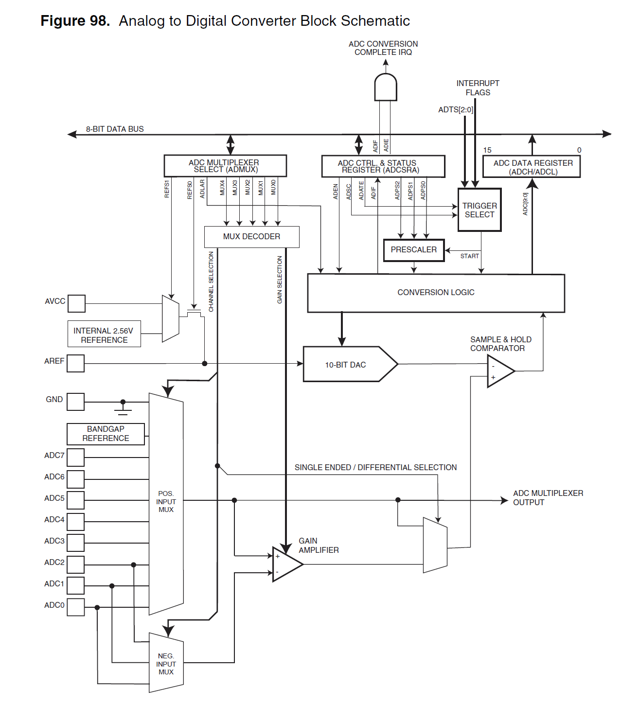

Slide 25
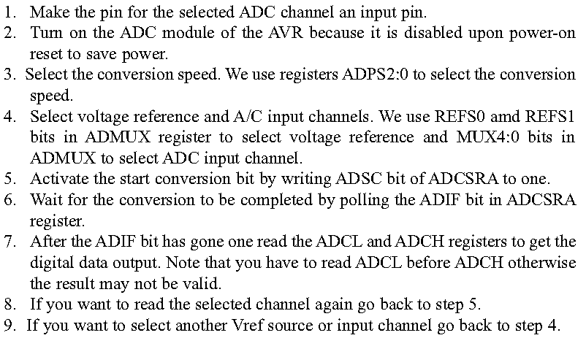
Programming ADC

Slide 26
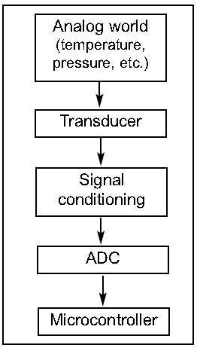
Signal conditioning
Thermo couple provides temp in form of uV
PT100 provides temp in form of resistance
Some humidity sensor provide the result in form of Capacitance
-> We have to change these signals to Voltage to convert it by ADC
This job is called signal conditioning

Slide 27
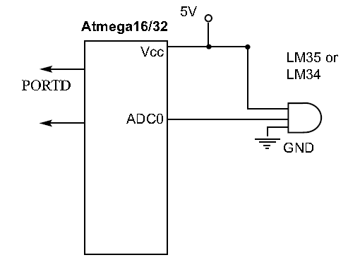
Sensor Interfacing

Slide 28
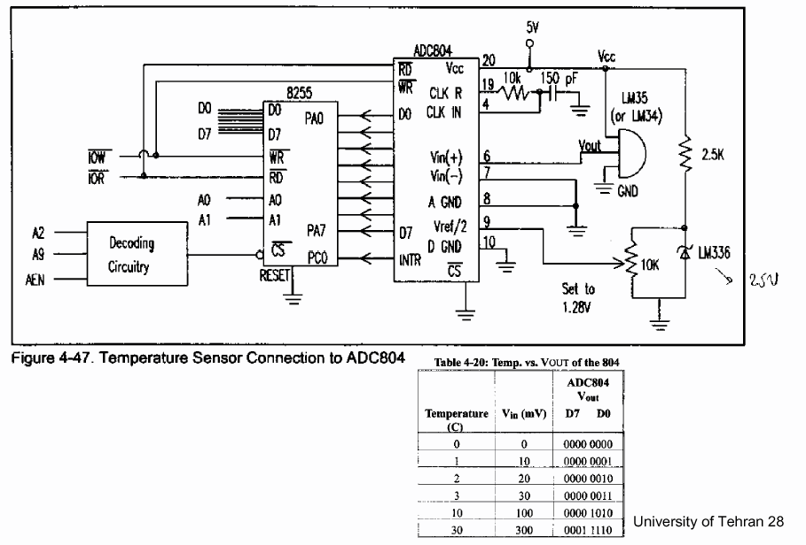
Temperature Sensor

Slide 29
Pulse width modulator
Generates pulses with specific high/low times
Duty cycle: % time high
Square wave: 50% duty cycle
Common use: generate clock like signals for another device, or control average voltage to an electric device
Simpler than DC-DC converter or digital-analog converter
DC motor speed, dimmer lights
Another use: encode commands, receiver uses timer to decode
1 ms interval ➔ command A
2 ms interval ➔ command B
4 ms interval ➔ command C, etc.
pwm_o
- 5V
- 0V
- 5V
- 0V
clk
25% duty cycle – average pwm_o is 1.25V
pwm_o
- 5V
- 0V
clk
- 5V
- 0V
50% duty cycle – average pwm_o is 2.5V.
pwm_o
- 5V
- 0V
- 5V
- 0V
clk
75% duty cycle – average pwm_o is 3.75V.

Slide 30
Controlling a DC motor with a PWM
We wish to control the speed of a DC motor, which is proportional to the voltage applied to the motor. PWM can be used to provide average voltages to control the motor rpm.
clk
clk_div
8bit counter
( 0 – 254)
controls period ➔ how fast the counter increments
counter ≤ cycle_high,
pwm_o = 1
counter≥cycle_high,
pwm_o = 0
8-bit
comparator
pwm_o
Cycle_high = FF ➔ duty=100% Cycle_high = 7F ➔ duty = 50%
Cycle_high = 00 ➔ duty = 0%
cycle_high
(8 bit)
Relationship between applied voltage and speed of the DC Motor
Internal Structure of PWM
void main(void){
/* controls period */
PWMP = 0xff;
/* controls duty cycle */
PWM1 = 0x7f;
while(1){};
}
The PWM alone cannot drive the DC motor, a possible way to implement a driver is shown below using an NPN transistor.
5V
DC
MOTOR
5V
From processor
A
B

Slide 31
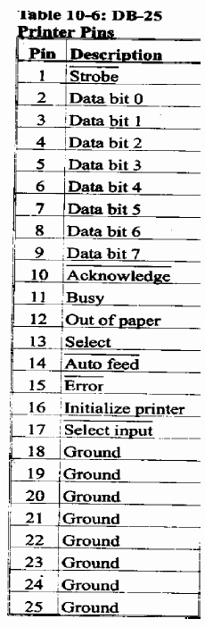
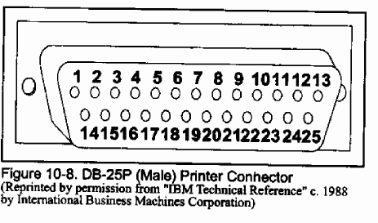
Printer Connection

Slide 32
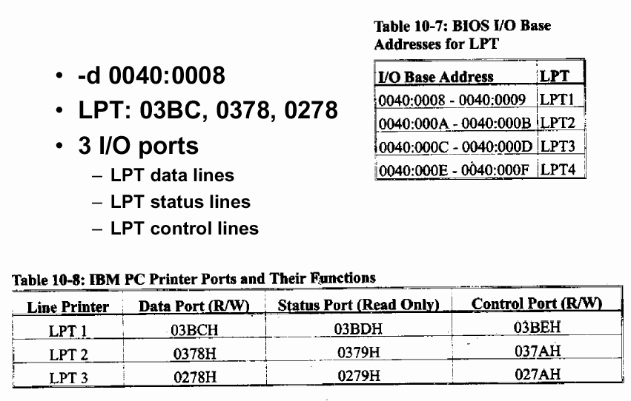
IO Base Address for LPT

Slide 33
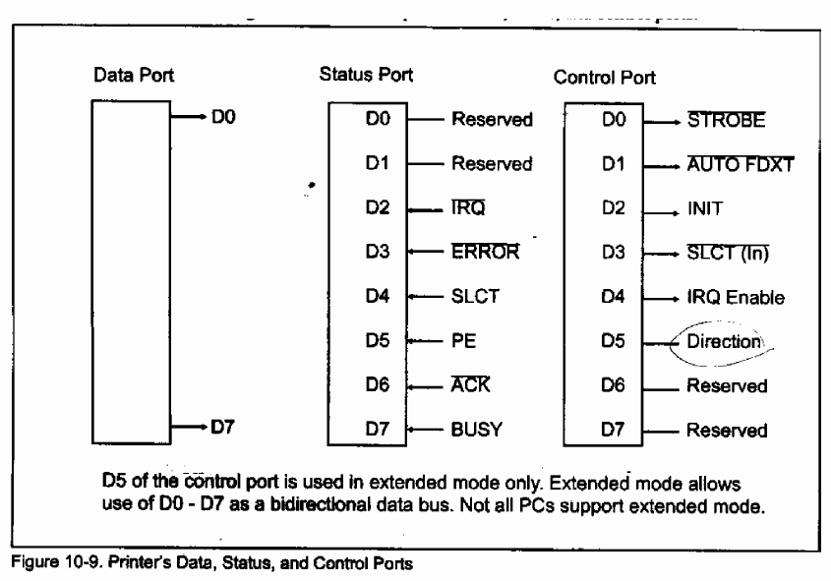
Printer’s Ports

Slide 34
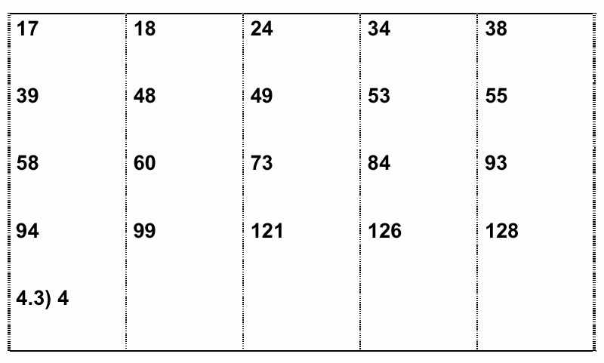
Selected Problems (Ch. 4)

